Slide 1

Remember to…
Sign in on the app (at home and in class)
Wipe your desk before and after use (if you are in the class / on campus)
Connect your phone to eduroam to help our internal track and trace ☺ (if you are on campus)

Slide 2

BS1220: Introduction to Software Design and Development
Week 4 – Hybrid Session 1

Slide 3
4.5: Today’s Classes
Types of Selection Control Structure
Boolean Operations
If statements
If-else statements
If-elseif-else statements
Pass keyword
Nesting

Slide 4
What did you find in your research?
What are selection control structures?
Why are selection control structures useful?
What is a conditional statement?
What data type does a conditional have to be?
What is an if statement?
How are if statements represented in pseudocode?
How are conditional statements used within if statements?
What is an else statement?
In terms of programming, what is a switch statement?
What is the purpose of a case?
What is the default case?
Why is the default case useful?

Slide 5

4.6: Boolean Conditions
Boolean = values which are either true or false
Take care with letter cases in Python – must be True or False
Queries which compare two values
Aka Relational Operators
< / <=
> / >=
==
!=

Slide 6

Boolean Operators
Aka – Logical operator
Allow us to combine Boolean conditions
AND
OR
NOT
NAND
NOR
XOR

Slide 7
Your Activity
In your groups, you need to create a poster detailing what your specified Boolean condition or operator does.
You need to include:
What the Boolean operator / condition is
How the Boolean operator / condition works
An example of the Boolean operator / condition in practice
The benefits of the Boolean operator / condition
The drawbacks of the Boolean operator / condition
How the Boolean operator / condition is used within Python

Slide 8
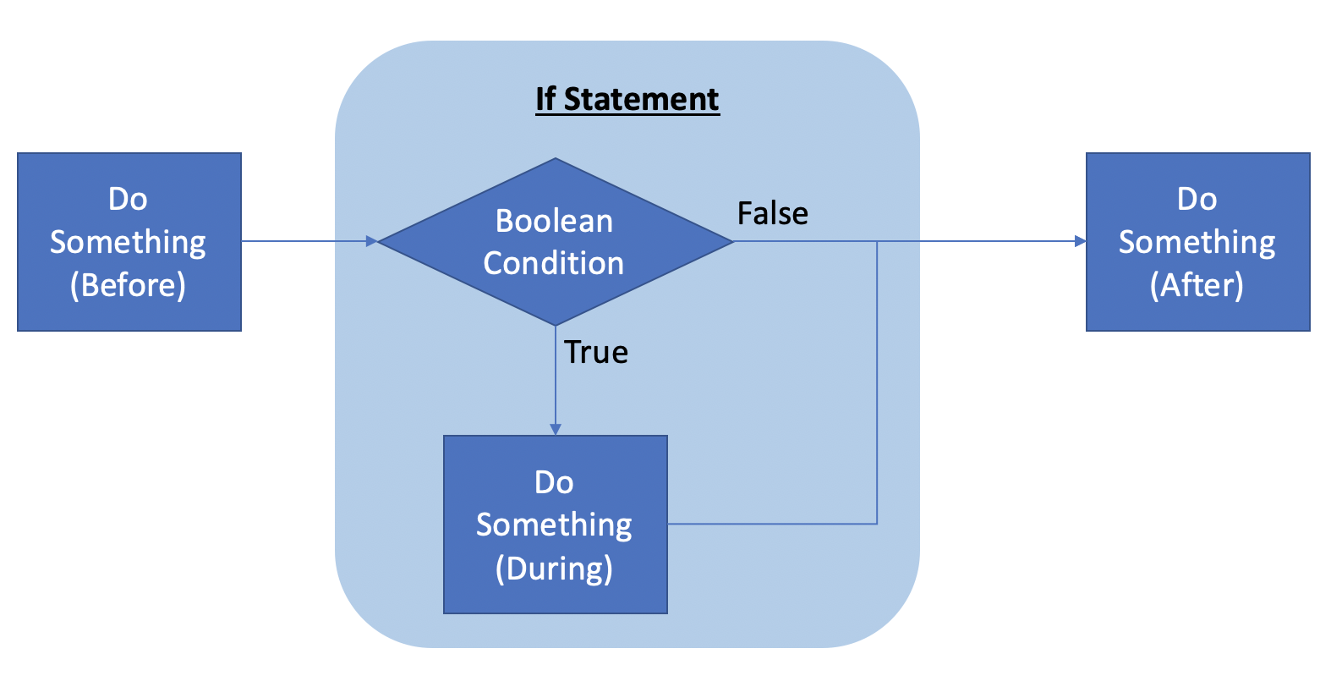
4.7: If Statement
# code before # if statement if(booleanCondition): # code during # code after

Slide 9

Demo
Developing if statements in Python

Slide 10
Your Turn
Write a program which asks the user to enter the day of the week and displays the following message if the day is Friday:
“Payday! :)”
Don’t forget to make use of functions!
(Note: for this program, we are assuming that the person gets paid each week on a Friday)
Extension for people who finish quickly – you will have probably programmed your system in such a way that it is case sensitive. How might you overcome this issue?

Slide 11

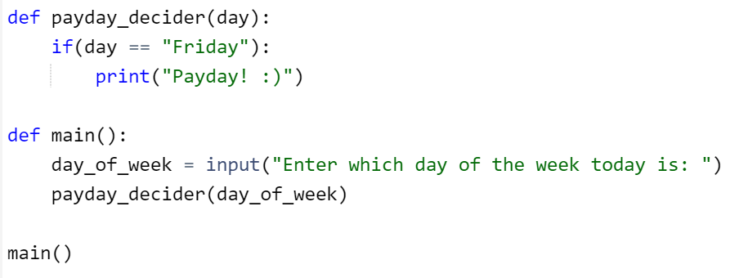
Solution

Slide 12
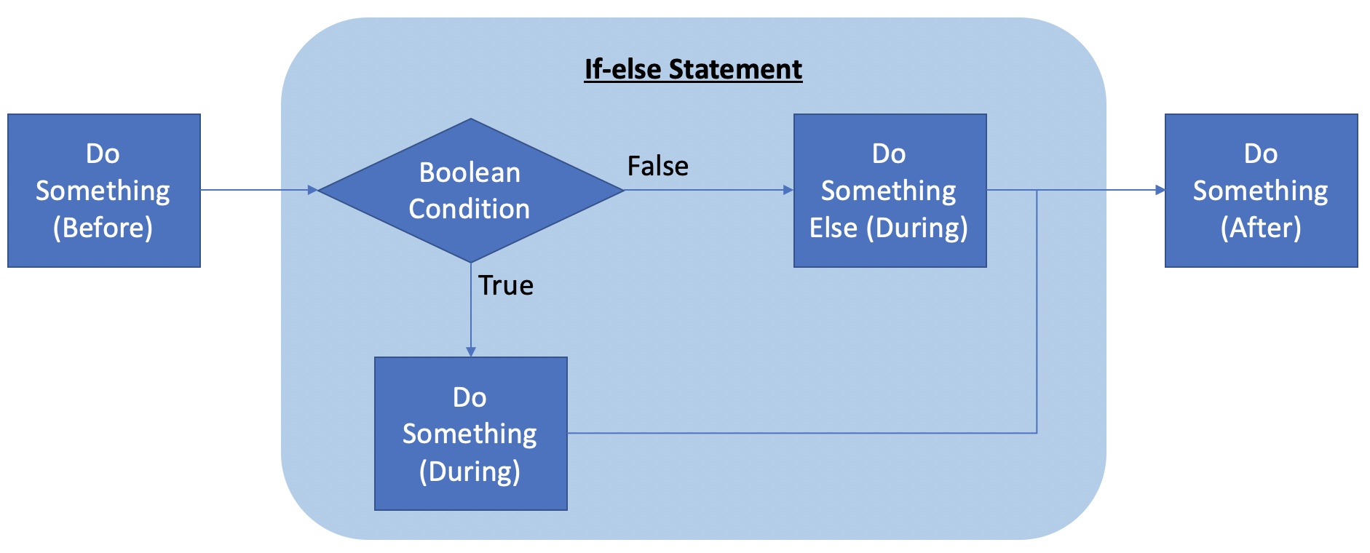
4.8: If-else
# code before # if statement if(booleanCondition): # code during
else:
# else code during # code after

Slide 13

Demo
Developing if-else statements

Slide 14
Your Turn
Adapt your program payday program so that when the user doesn’t enter Friday it now says:
“Not Payday :(”
It should still say “Payday!” when the user enters Friday
(Note: for this program, we are assuming that the person gets paid each week on a Friday)

Slide 15
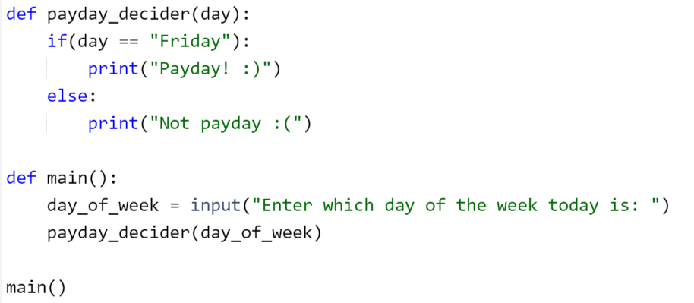
Solution

